Slide 1

DBA5103
Operations Research and Analytics
Zhenyu Hu
Semester I, 2026/2027

Slide 2
Linear Programming
and
Its Applications

Slide 3
Prototype Example
Wyndor Glass Co.
  Produces windows and glass doors
  Plant 1 makes aluminum frames and hardware
  Plant 2 makes wood frames
  Plant 3 produces glass and assembles products

Slide 4
Prototype Example
Company introducing two new products
  Product 1: 8 ft. glass door with aluminum frame
  Product 2: 4 x 6 ft. double-hung, wood-framed window
Problem: What mix of products would be most profitable?

Slide 5
Prototype Example
Data needed
  Number of hours of production time available per week in each plant for new products
  Production time used in each plant for each batch of each new product
  Profit per batch of each new product
  Demand

Slide 6
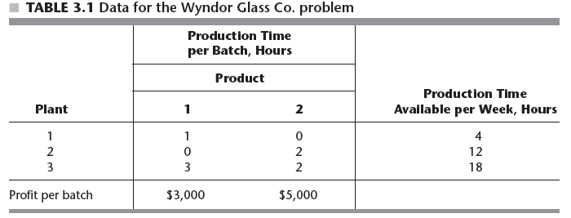
Prototype Example
Demand: assume that all products produced can be sold.

Slide 7
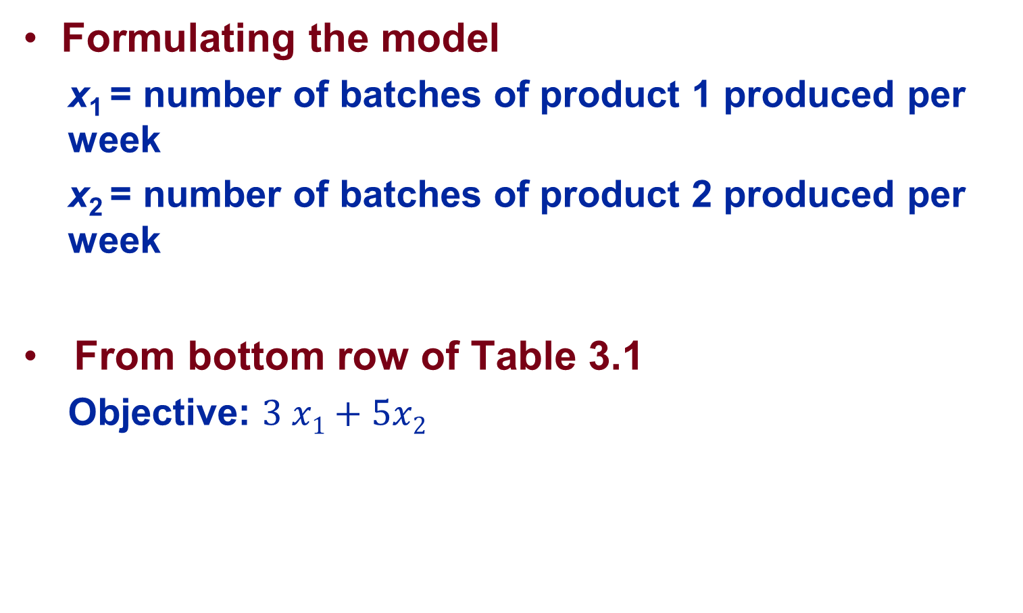
Prototype Example
Formulating the model
  x₁ = number of batches of product 1 produced per week
  x₂ = number of batches of product 2 produced per week
From bottom row of Table 3.1
  Objective: $3 x1+5x2$

Slide 8
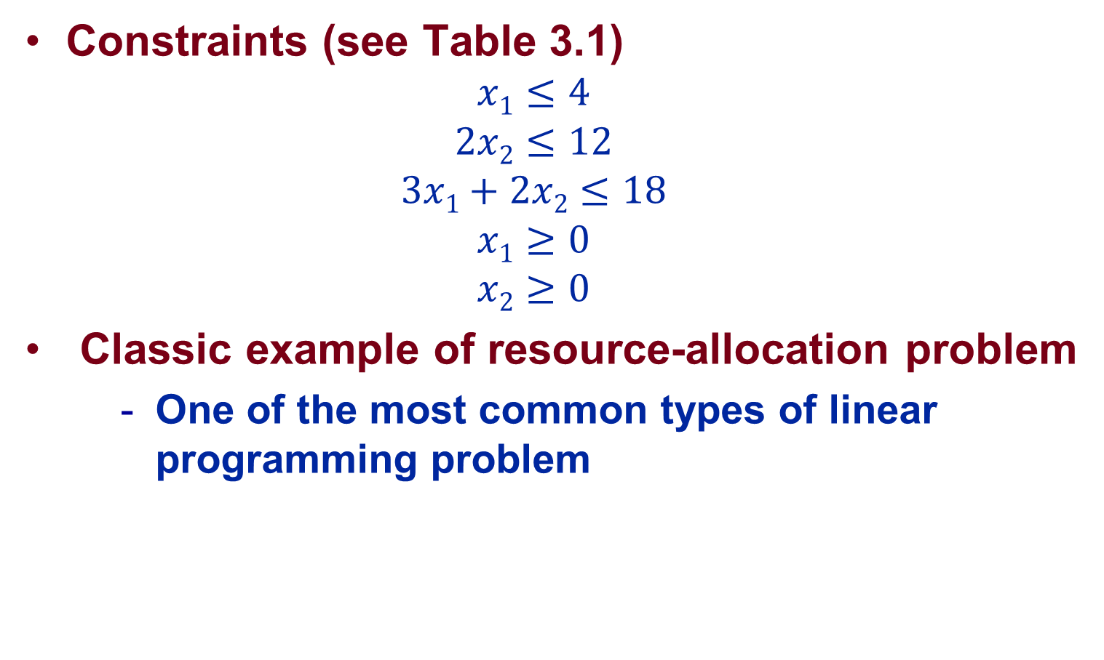
Prototype Example
Constraints (see Table 3.1)
  $$x1≤4$$
  $$2x2≤12$$
  $$3x1+2x2≤18$$
  $$x1≥0$$
  $$x2≥0$$
Classic example of resource-allocation problem
  One of the most common types of linear programming problem

Slide 9
Prototype Example
Alternative formulation 1
  x₁ = number of batches of product 1 produced per week
  s₁ = production time reserved at plant 1
  x₂ = number of batches of product 2 produced per week
Alternative formulation 2
  x_{i} = number of batches of product i produced per week, i=1,2
  s_{j} = production time reserved at plant j, j=1,2,3

Slide 10
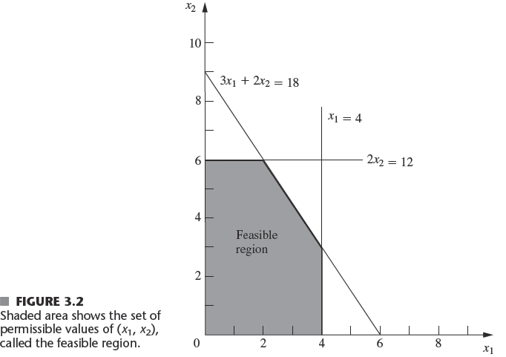
Graphical Approach/Contour Approach

Slide 11
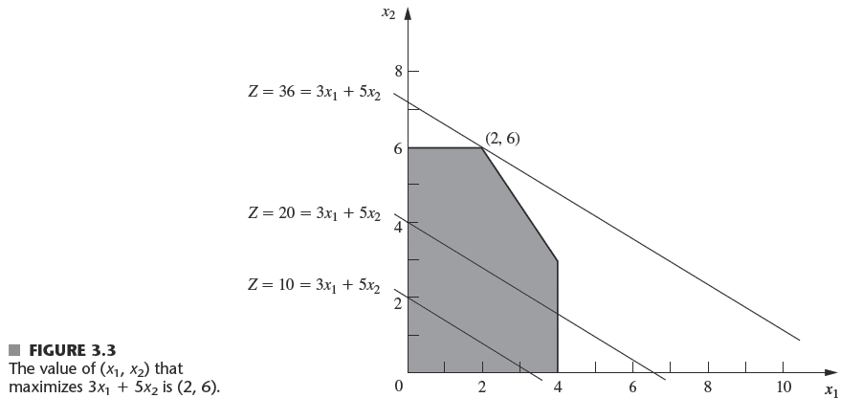
Graphical Approach/Contour Approach

Slide 12
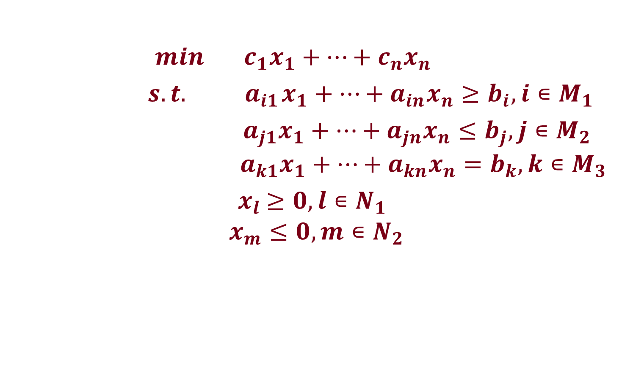
A General Linear Programming Problem
$min c_{1}x_{1}+…+c_{n}x_{n}$
$s.t.{ a}_{i1}x_{1}+…+a_{in}x_{n}≥b_{i}, i∊M_{1}$
${ a}_{j1}x_{1}+…+a_{jn}x_{n}≤b_{j}, j∊M_{2}$
$${ a}_{k1}x_{1}+…+a_{kn}x_{n}=b_{k}, k∊M_{3}$$
${ x}_{l} ≥0, l∊N_{1}$
$$x_{m}≤0, m∊N_{2}$$
Linear functions
Finite

Slide 13
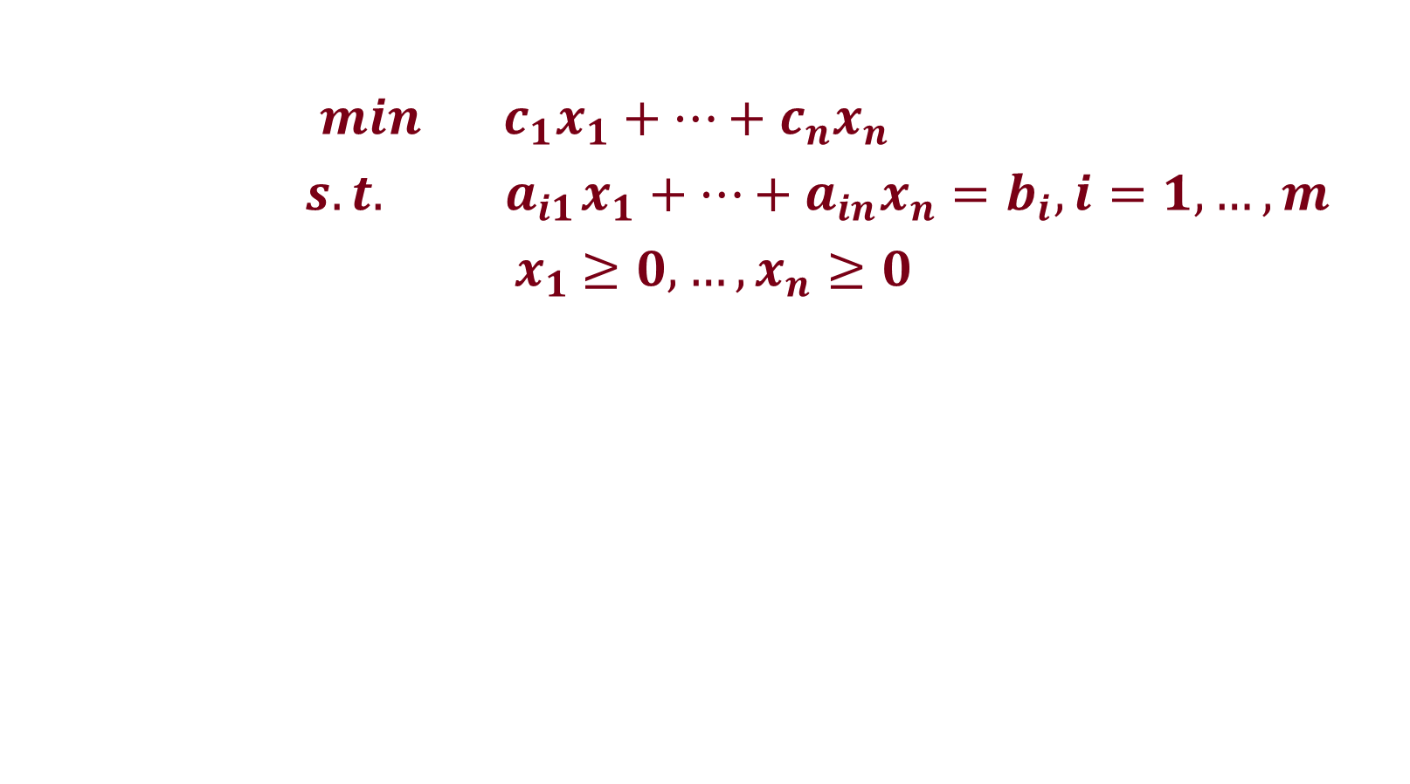
Standard Form
$min c_{1}x_{1}+…+c_{n}x_{n}$
$s.t.{ a}_{i1}x_{1}+…+a_{in}x_{n}=b_{i}, i=1,…,m$
${ x}_{1} ≥0, …,x_{n}≥0$

Slide 14
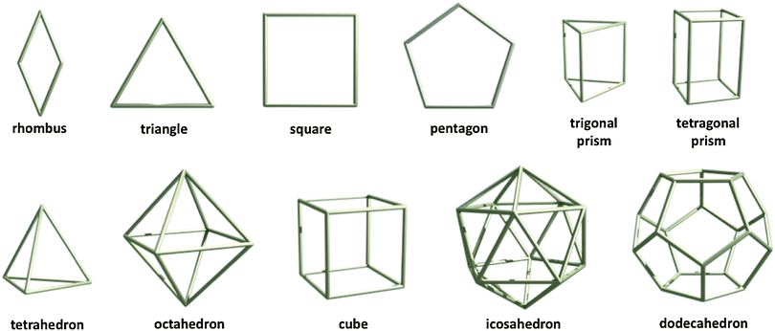
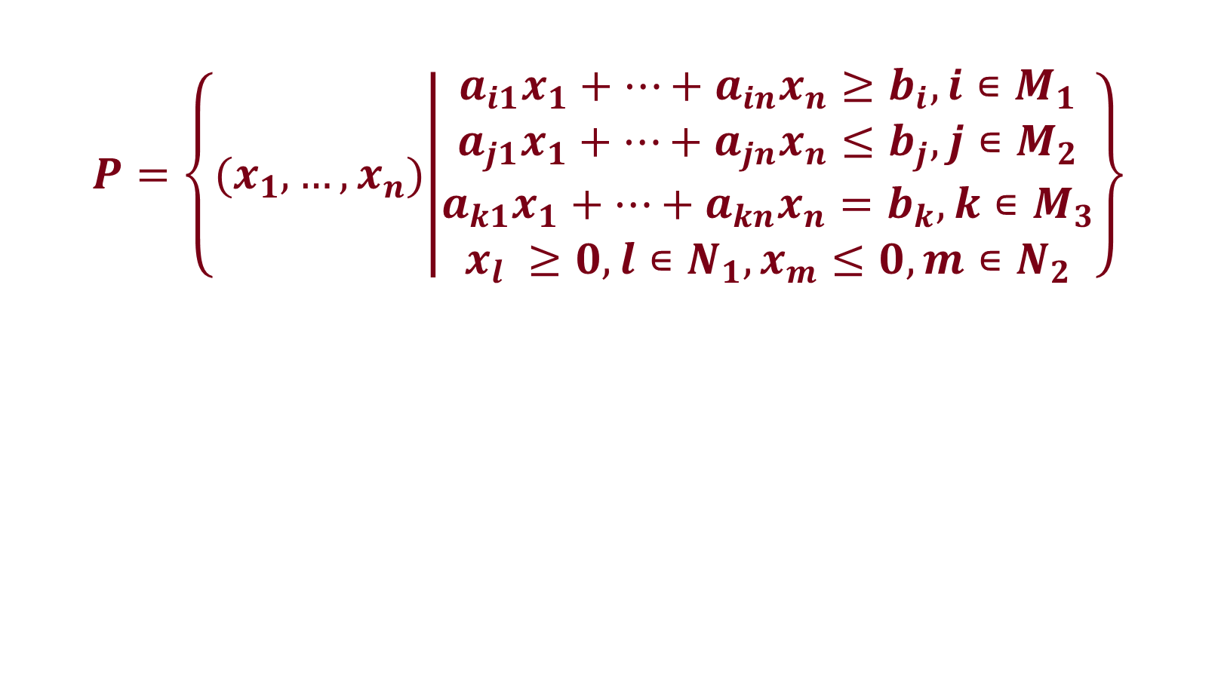
Polyhedron
$$P=\left\{{(x}_{1},…,x_{n}) | \begin{matrix}a_{i1}x_{1}+…+a_{in}x_{n}≥b_{i}, i∊M_{1} \\ a_{j1}x_{1}+…+a_{jn}x_{n}≤b_{j}, j∊M_{2} \\ \begin{aligned}a_{k1}x_{1}+…+a_{kn}x_{n}=b_{k}, k∊M_{3} \\ x_{l} ≥0, l∊N_{1},x_{m}≤0, m∊N_{2}\end{aligned}\end{matrix}\right\}$$

Slide 15


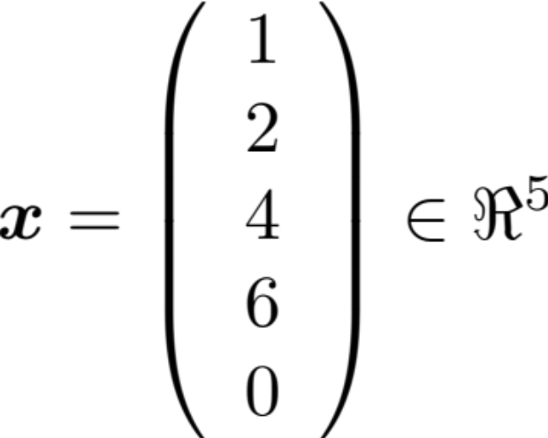

MATH 1001
Scalar
  Variable described by a single number
Vector
  Column of numbers
Linear Algebra & Matrices, MfD 2009

Slide 16
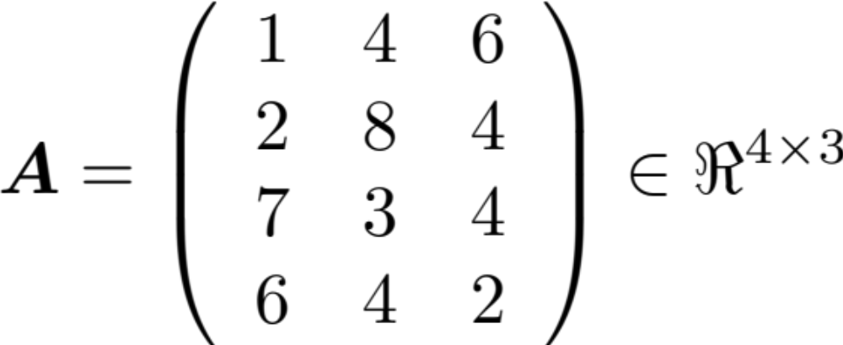

MATH 1001
Rectangular display of vectors in rows and columns
  Defined as rows x columns (R x C)
Vector is just a n x 1 matrix
Linear Algebra & Matrices, MfD 2009

Slide 17
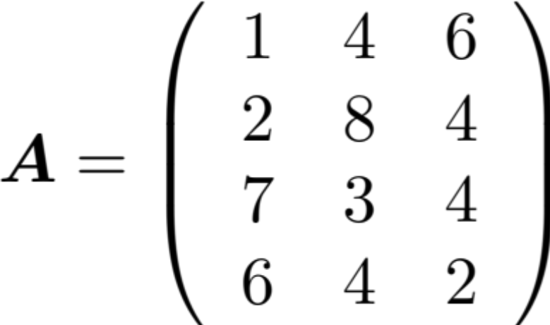

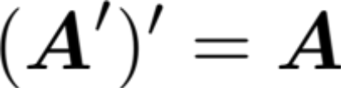
Transposition
Reflect over its main diagonal:
  Write the rows of A as the columns of A

Slide 18


Columns of Matrices
Linear Algebra & Matrices, MfD 2009

Slide 19
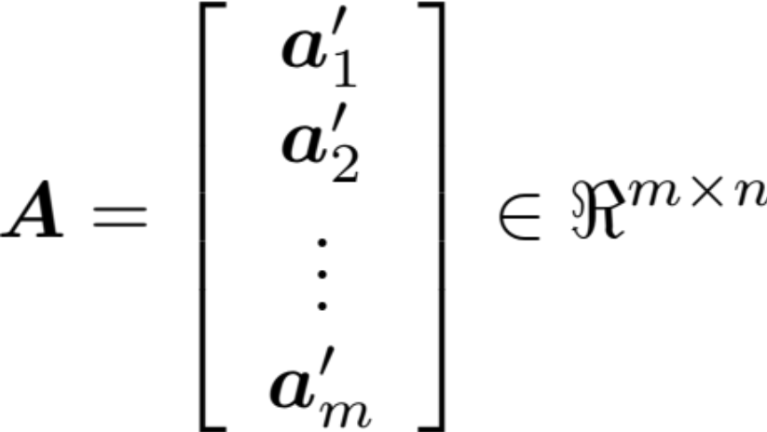


Rows of Matrices

Slide 20
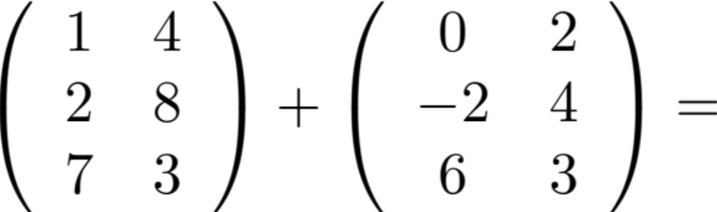
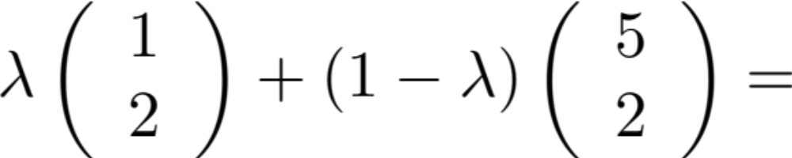
Matrix Calculations

Slide 21
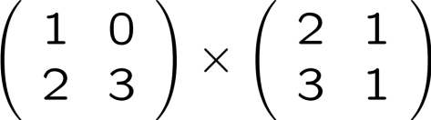
Matrix Multiplication
Multiplication method:
Sum over product of respective rows and columns
=
A
B

Slide 22
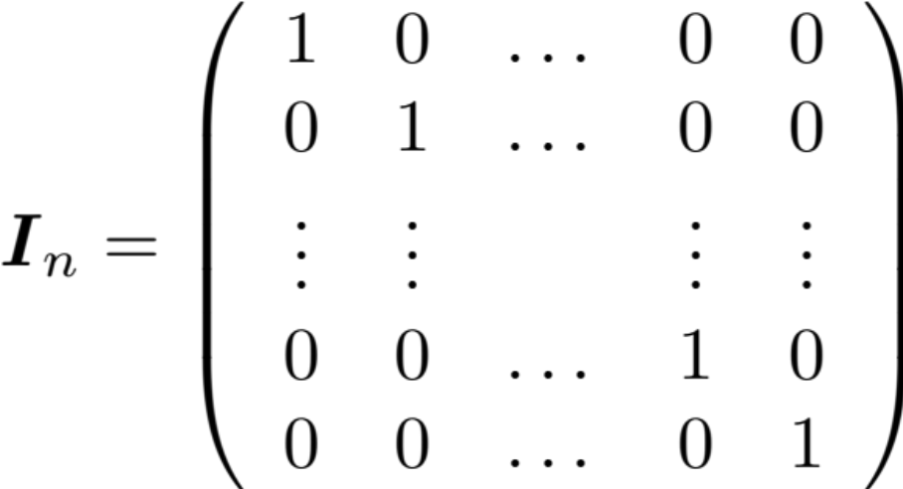
Identity Matrix
Is there a matrix which plays a similar role as the number 1 in number multiplication?
Consider the nxn matrix:
For any nxn matrix A, we have A I_{n} = I_{n} A = A

Slide 23


Matrix inverse
Definition. A matrix A is called nonsingular or invertible if there exists a matrix B such that:
1 | 1 | X | 2 3 | -1 3 | = | 2 + 1 3 3 | -1 + 1 3 3 | = | 1 | 0
-1 | 2 |  | 1 3 | 1 3 |  | -2+ 2 3 3 | 1 + 2 3 3 |  | 0 | 1
Notation. A common notation for the inverse of a matrix A is A⁻¹. So:
The inverse matrix is unique when it exists.

Slide 24
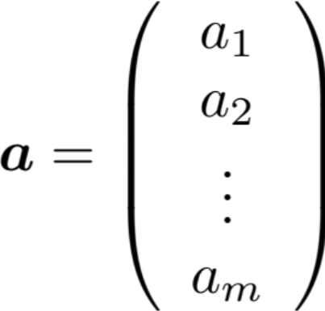
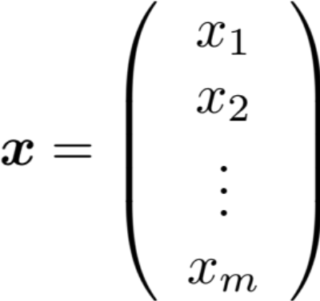

Matrix Multiplication

Slide 25


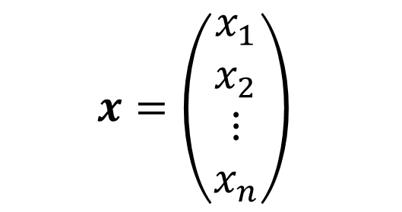
Matrix Multiplication
$$x=\left(\begin{aligned}x_{1} \\ x_{2} \\ ⋮ \\ x_{n}\end{aligned}\right)$$

Slide 26
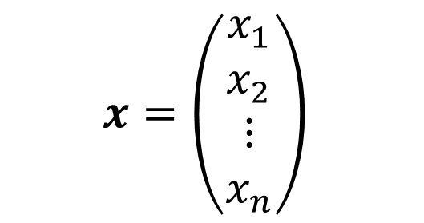
Matrix Multiplication
$$x=\left(\begin{aligned}x_{1} \\ x_{2} \\ ⋮ \\ x_{n}\end{aligned}\right)$$

Slide 27



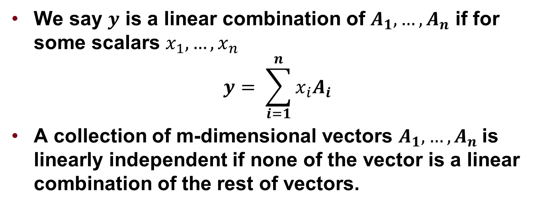



Linear Independence
We say $y$ is a linear combination of $A_{1},…,A_{n}$ if for some scalars $x_{1},…,x_{n}$
$$y= \sum_{i=1}^{n}{{x_{i}A}_{i}}$$
A collection of m-dimensional vectors $A_{1},…,A_{n}$is linearly independent if none of the vector is a linear combination of the rest of vectors.
$$A_{1}$$
$$A_{1}$$
$$A_{3}$$
$$A_{2}$$
$$A_{3}$$
$$A_{2}$$

Slide 28
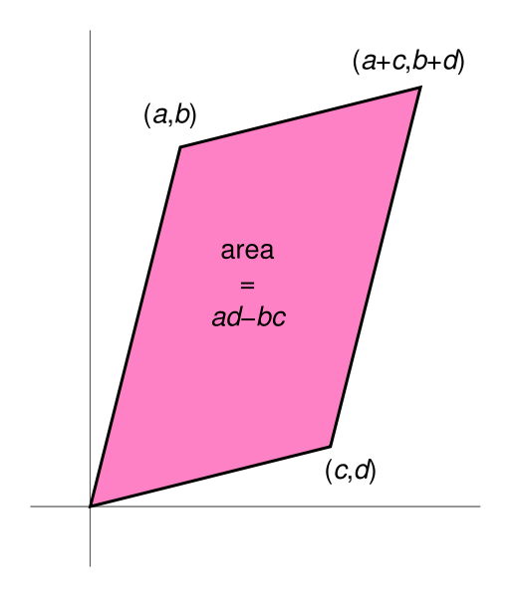
Determinant
The determinant is a function that associates a scalar det(A) to every square matrix A.
Determinants can only be found for square matrices as it is related to the volume of a parallelepiped (think about diagonal matrix).
[ ]
det(A) =
a b
c d
= ad - bc
What happens when (a, b) and (c, d) are linearly dependent?
If elements in A are integers, is det(A) an integer?

Slide 29
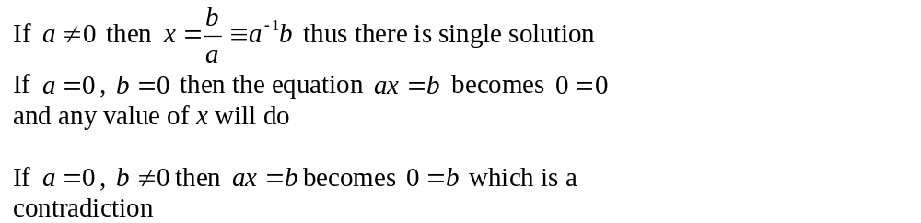
Solving simultaneous equations
For one linear equation ax=b where the unknown is x and b are constants, we have three possibilities:

Slide 30
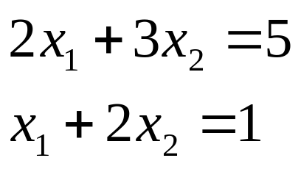
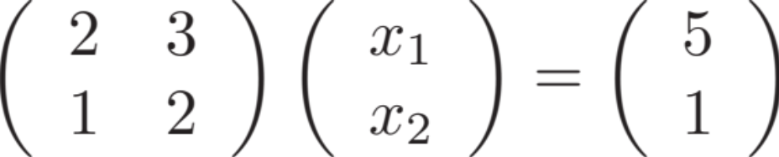

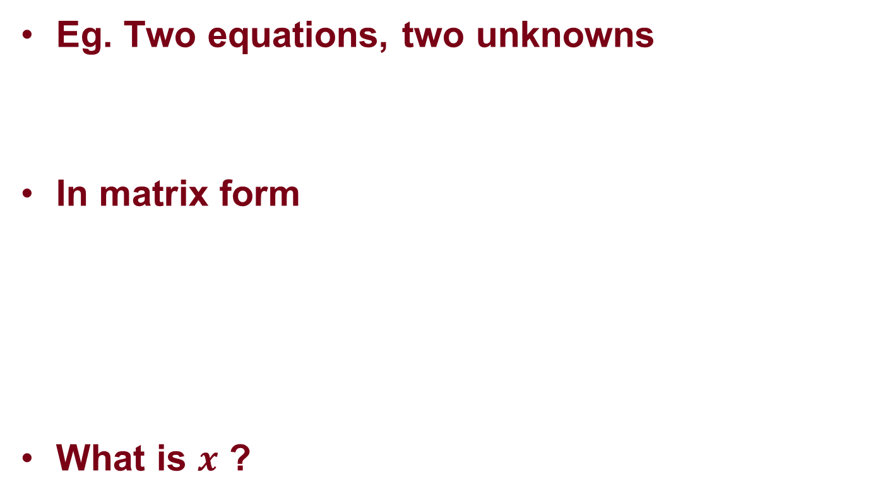
Solving simultaneous equations
Eg. Two equations, two unknowns
In matrix form
What is $x$ ?

Slide 31
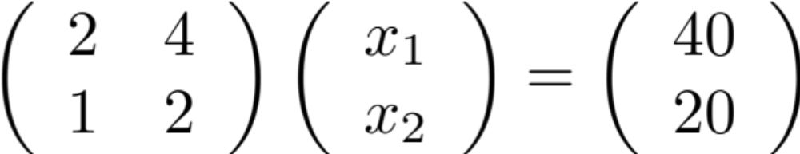

Solving simultaneous equations
If A is not invertible …

Slide 32
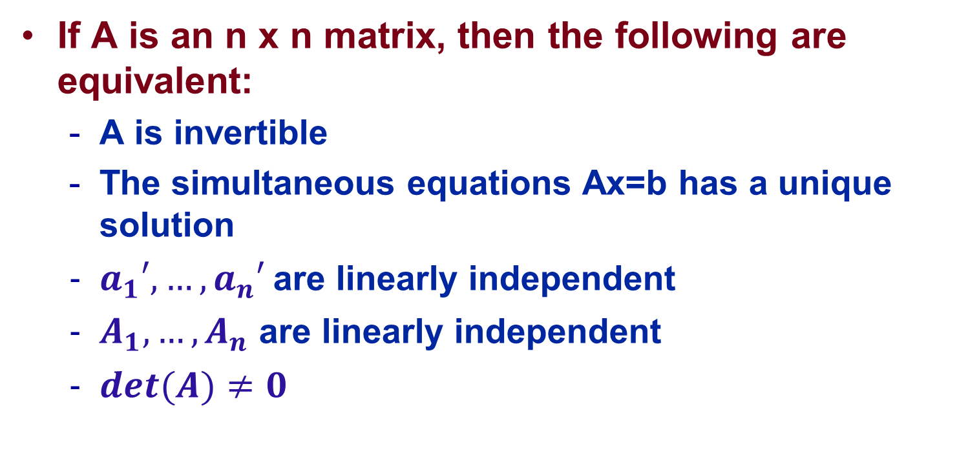
Summary
If A is an n x n matrix, then the following are equivalent:
  A is invertible
  The simultaneous equations Ax=b has a unique solution
  $a_{1}′,…,a_{n}′$ are linearly independent
  $A_{1},…,A_{n}$ are linearly independent
  $det(A)≠0$

Slide 33
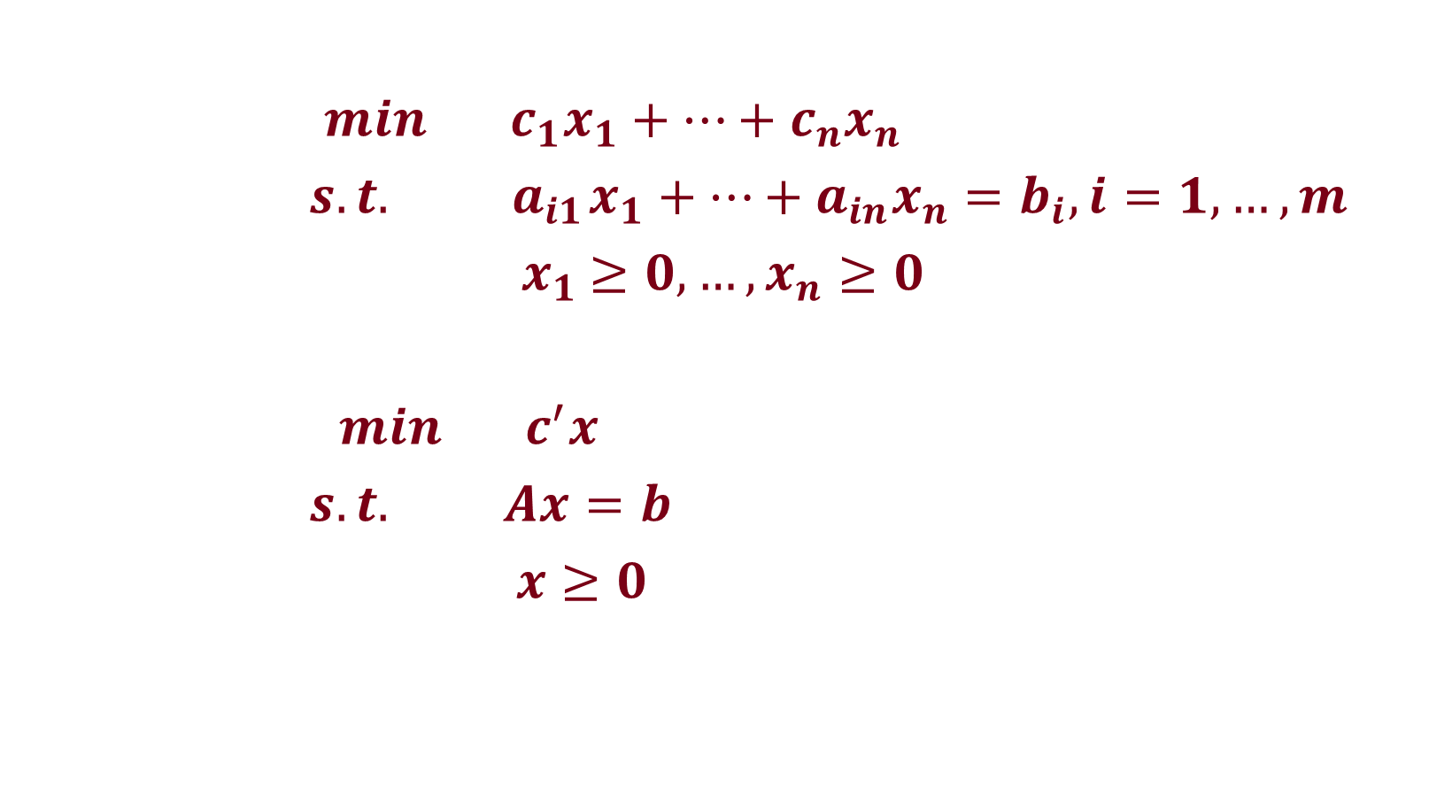
Back to Standard Form
$min c_{1}x_{1}+…+c_{n}x_{n}$
$s.t.{ a}_{i1}x_{1}+…+a_{in}x_{n}=b_{i}, i=1,…,m$
${ x}_{1} ≥0, …,x_{n}≥0$
$min c^{′}x$
$s.t. Ax=b$
$x≥0$

Slide 34
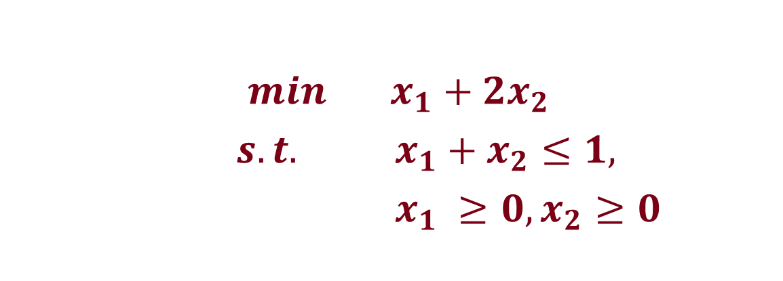
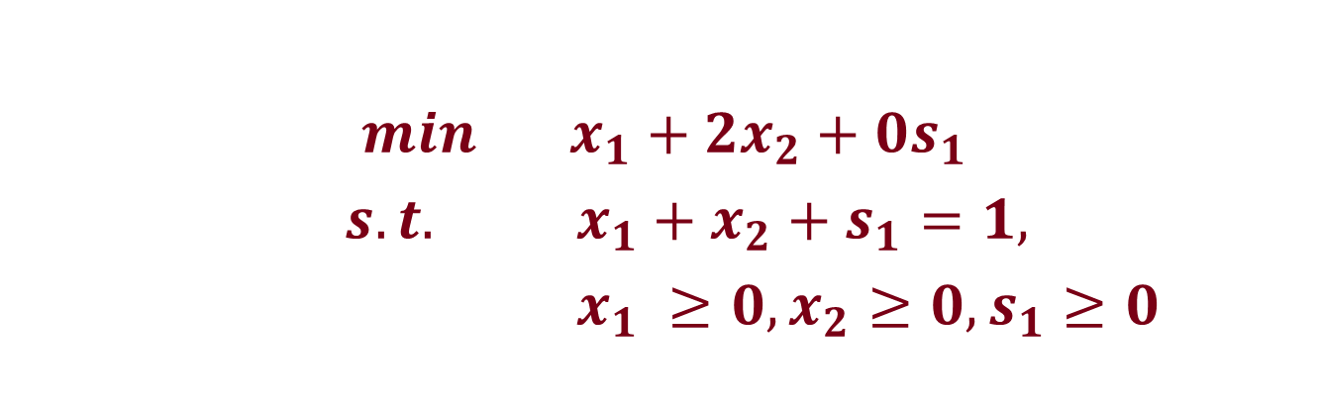
Reduction to Standard Form - Inequalities
$min x_{1}+{2x}_{2}$
$s.t. x_{1}+x_{2}≤1,$
$x_{1} ≥0, x_{2}≥0$
$min x_{1}+{2x}_{2}+0s_{1}$
$s.t. x_{1}+x_{2}+s_{1}=1,$
$x_{1} ≥0, x_{2}≥0,s_{1}≥0$

Slide 35
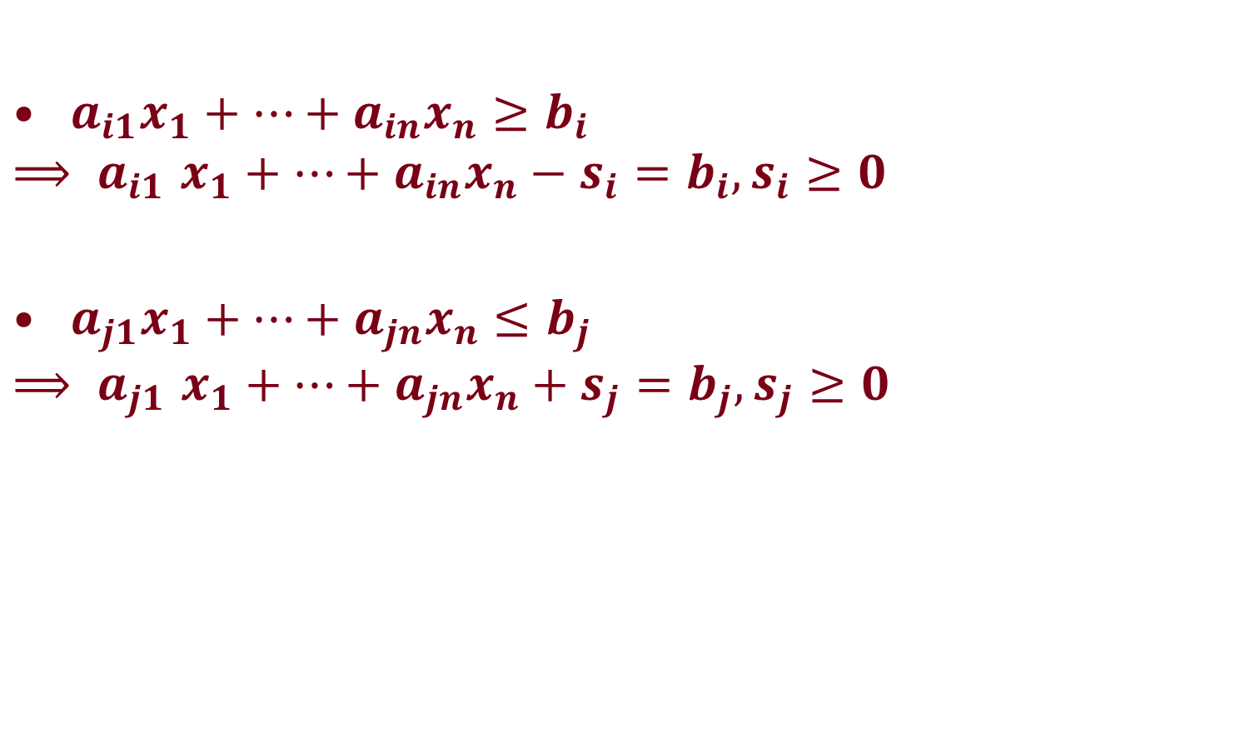
Reduction to Standard Form - Inequalities
${ a}_{i1}x_{1}+…+a_{in}x_{n}≥b_{i}$
$${⟹ a}_{i1}x_{1}+…+a_{in}x_{n}−s_{i}=b_{i},s_{i}≥0$$
${ a}_{j1}x_{1}+…+a_{jn}x_{n}≤b_{j}$
$${⟹ a}_{j1}x_{1}+…+a_{jn}x_{n}+s_{j}=b_{j},s_{j}≥0$$

Slide 36
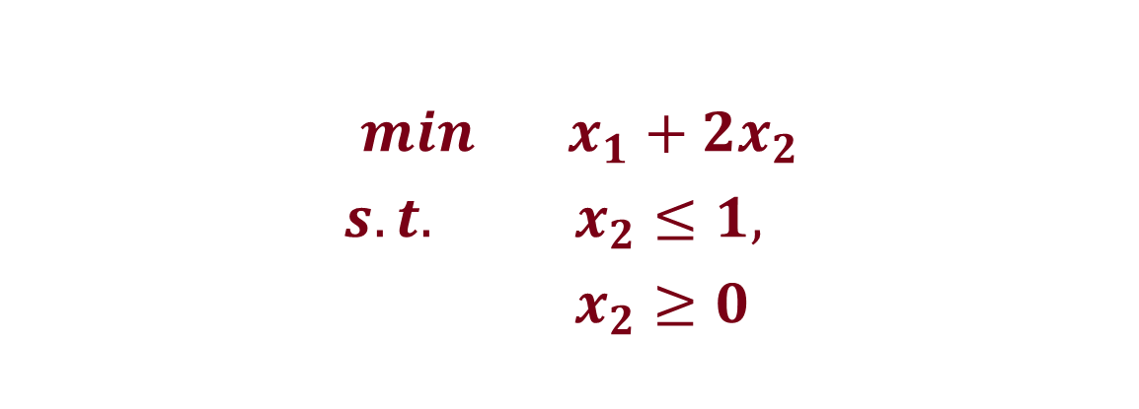
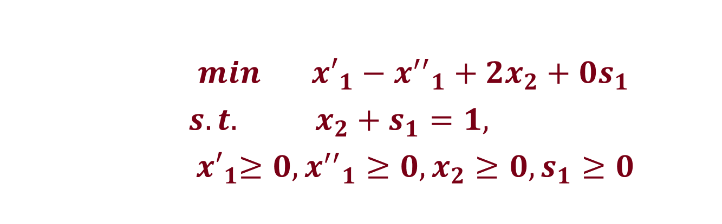
Reduction to Standard Form - Variables
$min x_{1}+{2x}_{2}$
$s.t. x_{2}≤1,$
$x_{2}≥0$
$min { x′}_{1}−{x^{′′}}_{1}+{2x}_{2}+0s_{1}$
$s.t. x_{2}+s_{1}=1,$
${ x′}_{1}≥0, {{x^{′′}}_{1}≥0,x}_{2}≥0,s_{1}≥0$

Slide 37
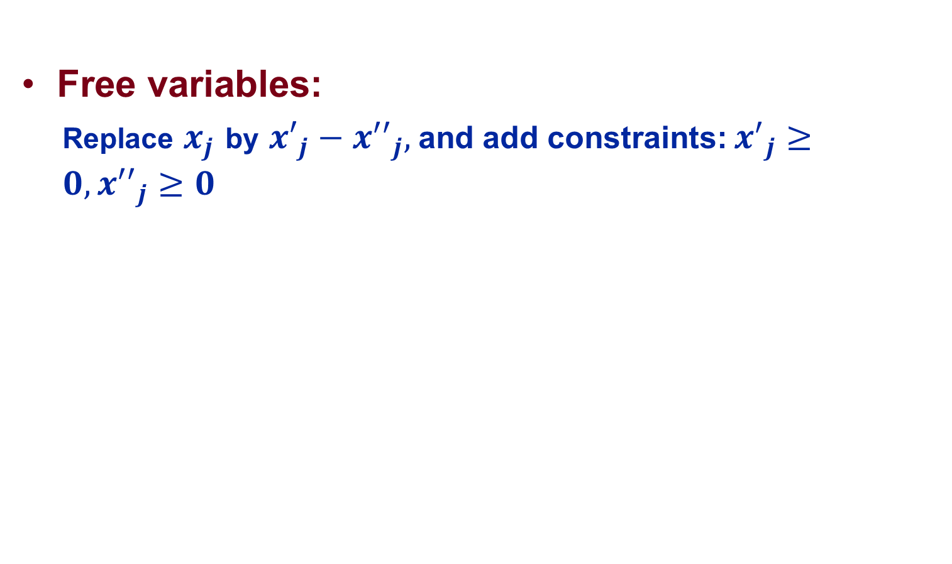
Reduction to Standard Form - Variables
Free variables:
  Replace $x_{j}$ by ${x′}_{j}−{x^{′′}}_{j},$ and add constraints: ${x^{′}}_{j}≥0,{x^{′′}}_{j}≥0$

Slide 38
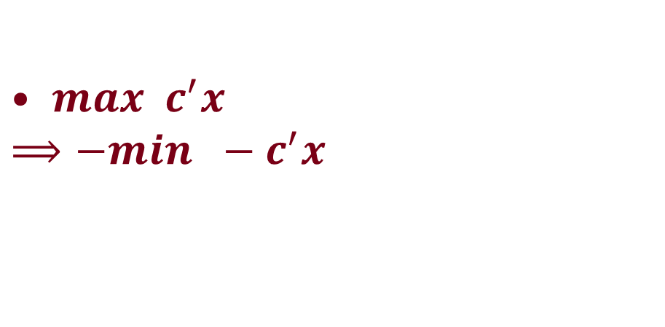
Reduction to Standard Form - Objective
$max c^{′}x$
$${⟹−min −c^{′}x }_{}$$

Slide 39
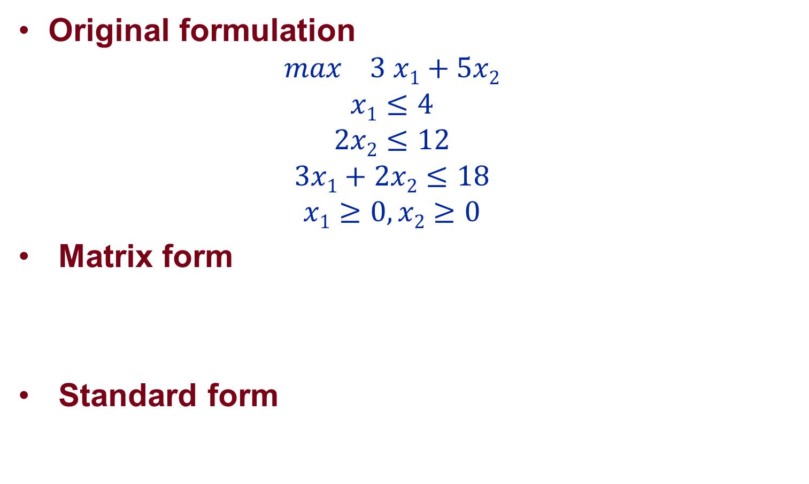
Wyndor Glass Co.
Original formulation
  $$max 3 x1+5x2$$
  $$x1≤4$$
  $$2x2≤12$$
  $$3x1+2x2≤18$$
  $$x1≥0,x2≥0$$
Matrix form
Standard form

Slide 40
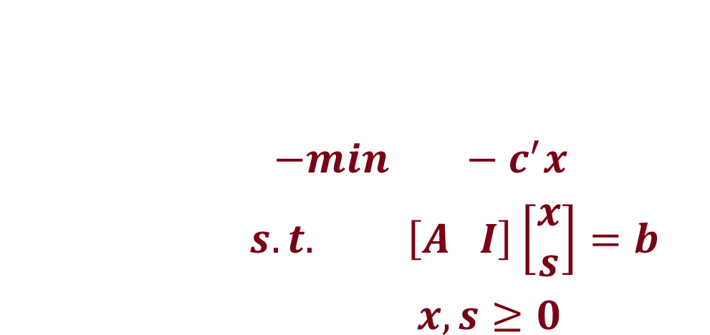
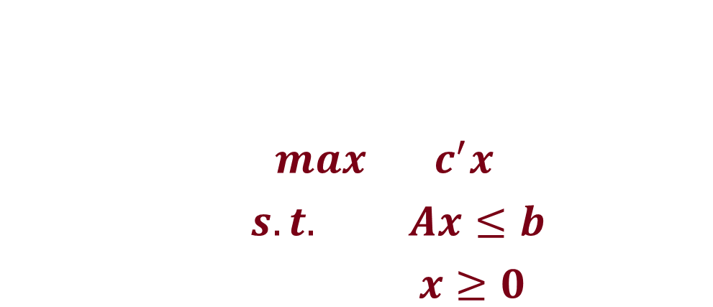
General Resource Allocation Problem
$max c^{′}x$
$s.t. Ax≤b$
$x≥0$
$−min −c^{′}x$
$s.t. \left[A I\right]\left[\begin{aligned}x \\ s\end{aligned}\right]=b$
$x, s≥0$

Slide 41
More Applications

Slide 42
Simple Regression
(a_{i}, b_{i})
|b_{i} – xa_{i}|
b = xa

Slide 43
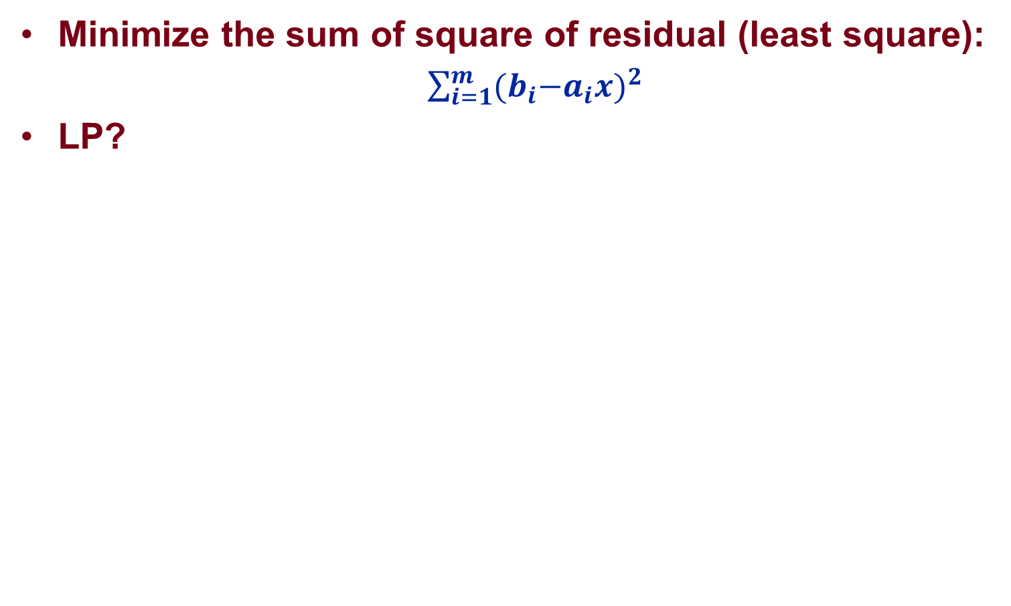
Data Fitting Problem: L2 Criterion
Minimize the sum of square of residual (least square):
  $\sum_{i=1}^{m}{{{(b}_{i}−a_{i}x)}^{2}}$
LP?

Slide 44
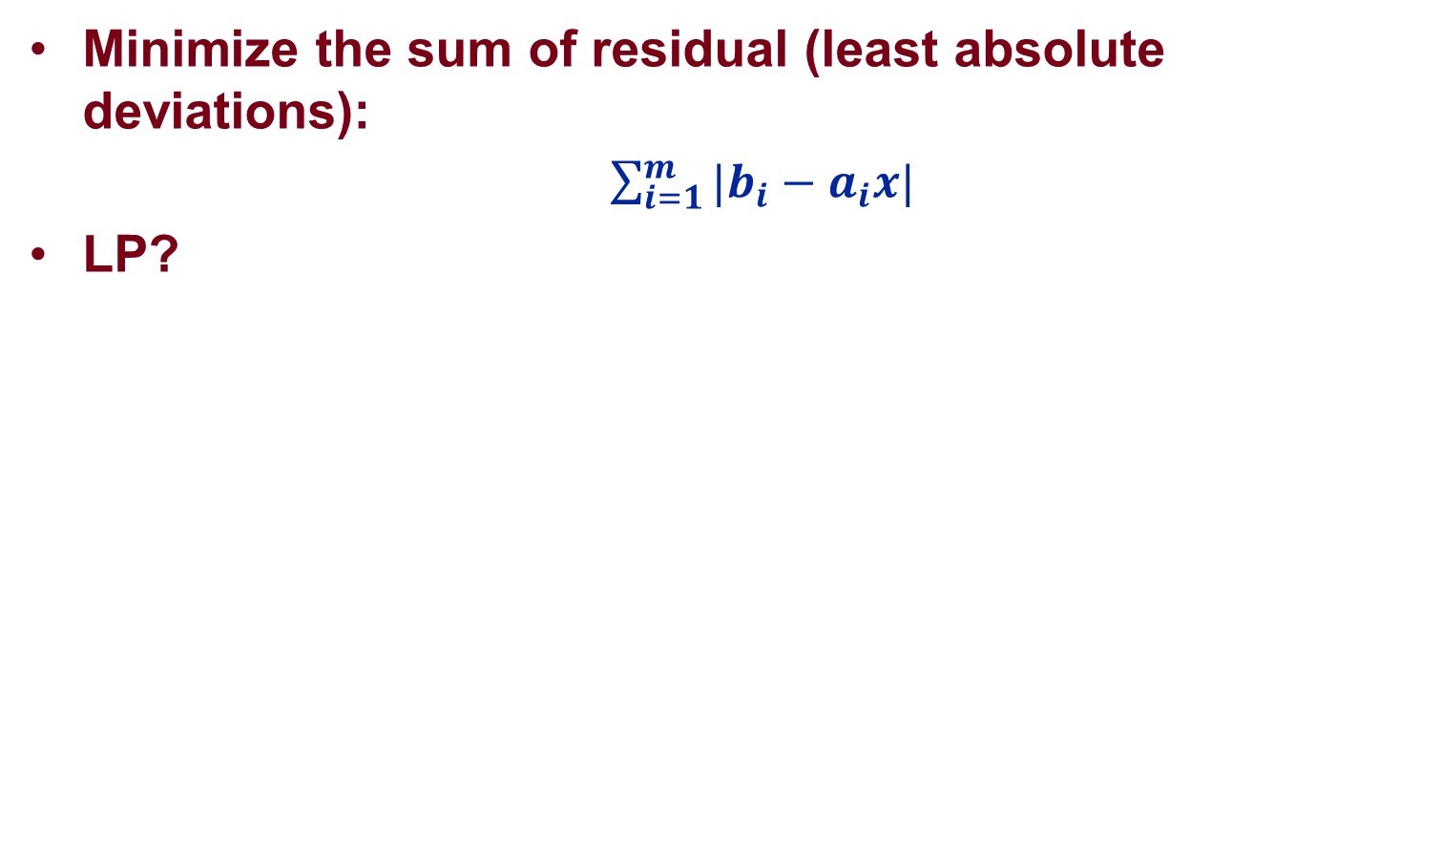
Data Fitting Problem: L1 Criterion
Minimize the sum of residual (least absolute deviations):
  $\sum_{i=1}^{m}{{|b}_{i}−a_{i}x|}$
LP?

Slide 45
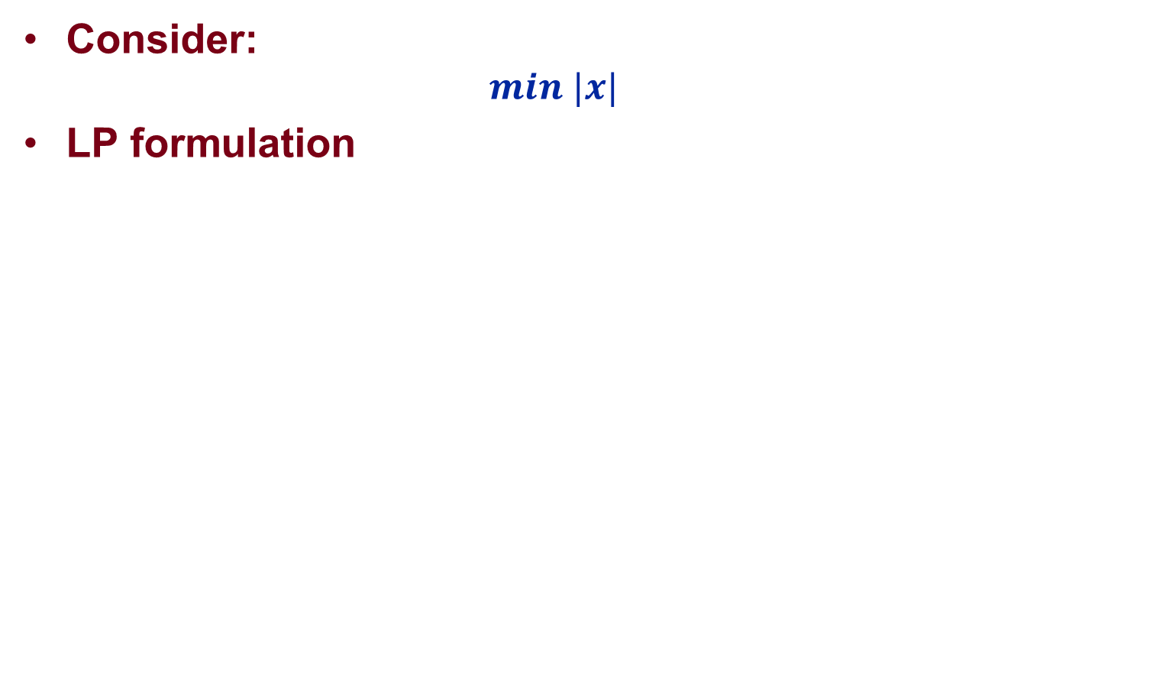
Data Fitting Problem: L1 Criterion
Consider:
  $$min |x|$$
LP formulation

Slide 46
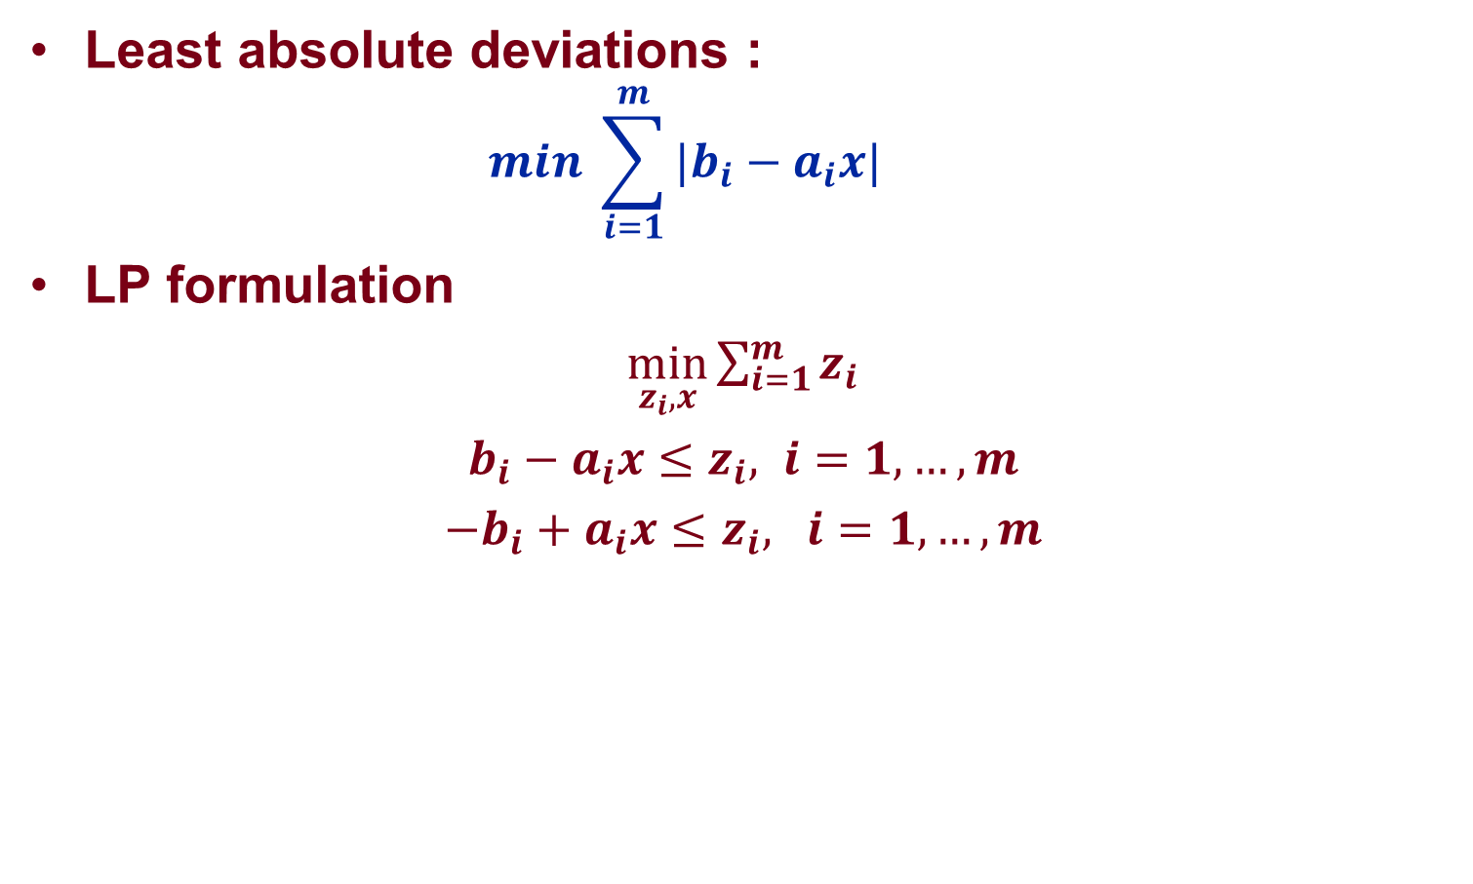
Data Fitting Problem: L1 Criterion
Least absolute deviations :
  $$min \sum_{i=1}^{m}{{|b}_{i}−a_{i}x|}$$
LP formulation
$\min_{z_{i},x}{\sum_{i=1}^{m}{z_{i}}}$
$b_{i}−a_{i}x≤z_{i}, i=1,…,m$
${−b}_{i}+a_{i}x≤z_{i}, i=1,…,m$

Slide 47
L1 vs. L2
Difficulty
Sensitivity to outliers
Solution uniqueness

Slide 48
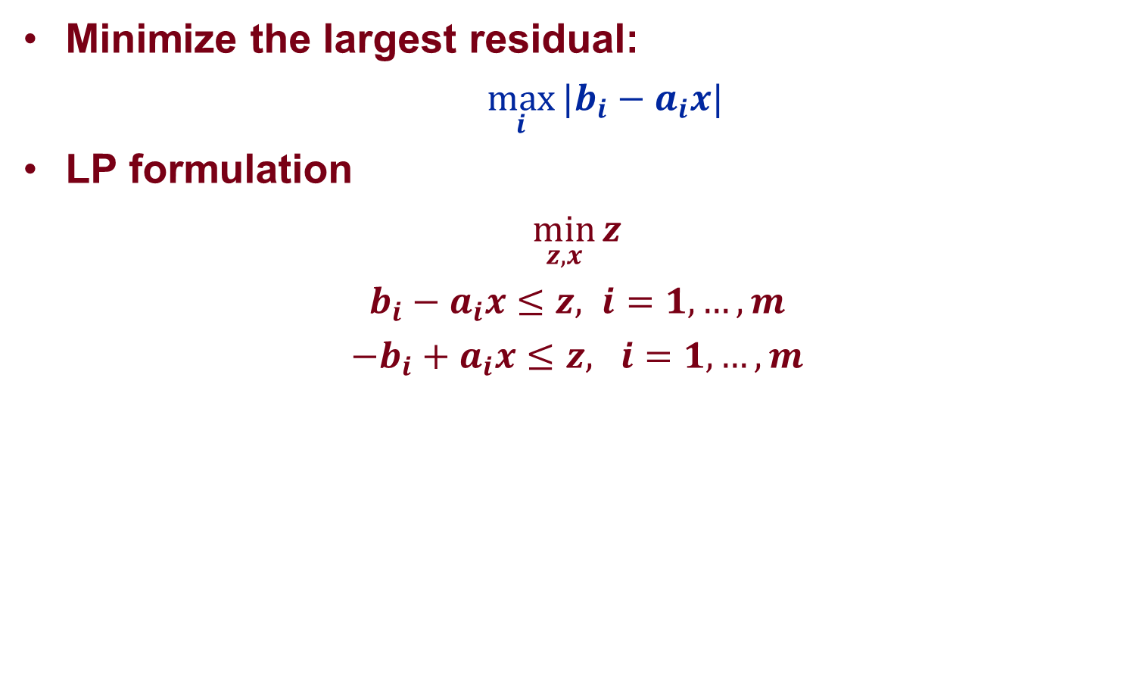
Data Fitting Problem: Chebyshev Criterion
Minimize the largest residual:
  $\max_{i}{{|b}_{i}−a_{i}x|}$
LP formulation
$\min_{z,x}{z}$
$b_{i}−a_{i}x≤z, i=1,…,m$
${−b}_{i}+a_{i}x≤z, i=1,…,m$

Slide 49
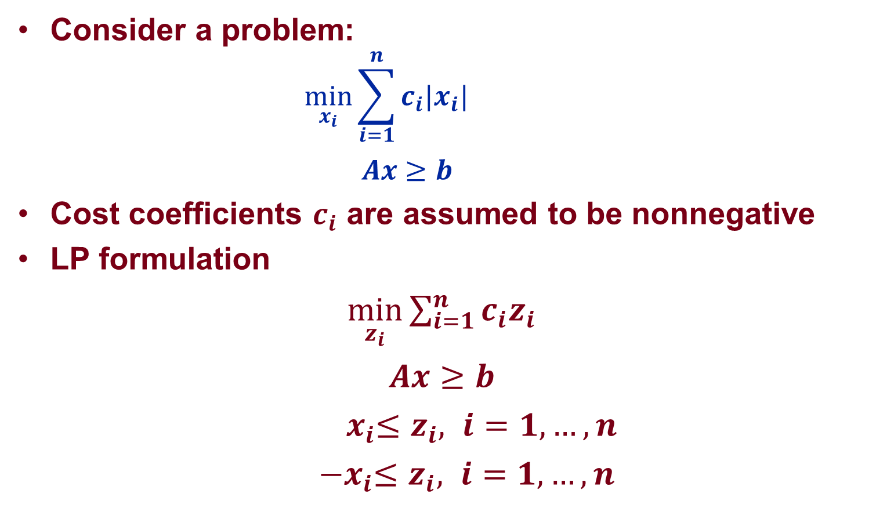
Problems Involving Absolute Values
Consider a problem:
  $$\min_{x_{i}}{{{\sum_{i=1}^{n}{{c_{i}|x}_{i}|}}_{}}_{}}$$
  $$Ax≥b$$
Cost coefficients $c_{i}$ are assumed to be nonnegative
LP formulation
$\min_{z_{i}}{\sum_{i=1}^{n}{{c_{i}z}_{i}}}$
$Ax≥b$
${ x}_{i}≤z_{i}, i=1,…,n$
${ −x}_{i}≤z_{i}, i=1,…,n$

Slide 50
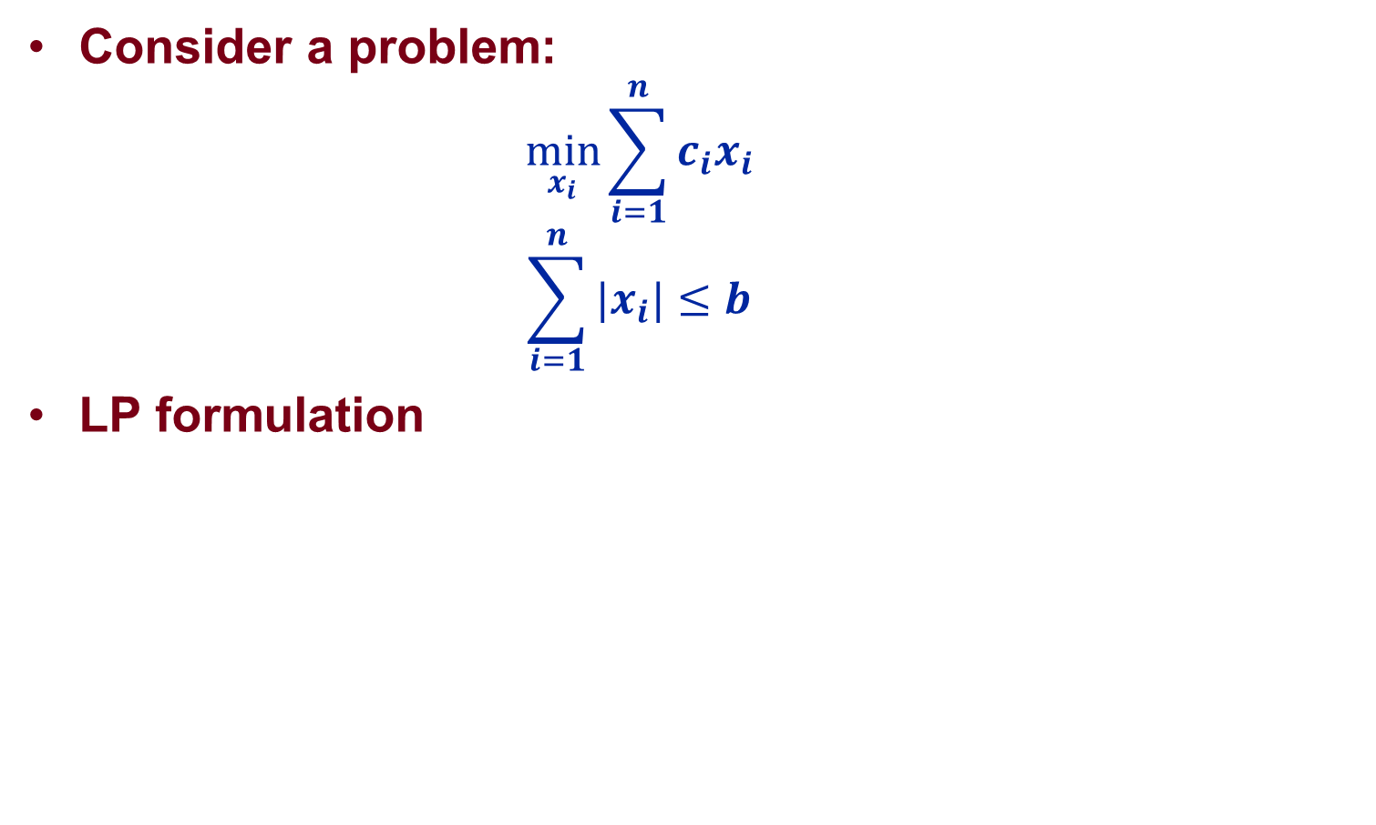
Problems Involving Absolute Values
Consider a problem:
  $$\min_{x_{i}}{\sum_{i=1}^{n}{{c_{i}x}_{i}}}$$
  $$\sum_{i=1}^{n}{{|x}_{i}|≤b}$$
LP formulation

Slide 51
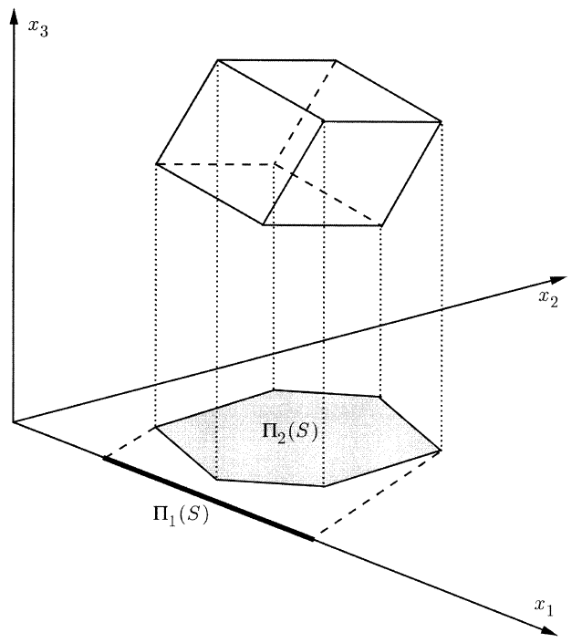
Projection/Lifting Idea

Slide 52
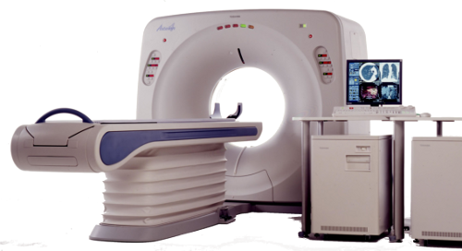
CT/MRI Scan

Slide 53

CT/MRI Scan
Source: http://engineering.dartmouth.edu/courses/engs167/12%20Image%20reconstruction.pdf

Slide 54

CT/MRI Scan
Source: http://engineering.dartmouth.edu/courses/engs167/12%20Image%20reconstruction.pdf

Slide 55

Compressed Sensing
Consider a signal (e.g. sound, images):
  $x=\left(x_{1}, …,x_{n}\right)′$,
  where n is very large (e.g. around 1,000,000).
The signal is not directly observable. Instead, one observes a measurement
  $b=Ax∈R^{m}$,
  where m is small and A is an mxn matrix.
The problem is then to find $x$given $b.$

Slide 56

Compressed Sensing: A Simple Example
Consider an unknown signal:
  $x=\left(0, 1\right)′$.
The measurement matrix is:
  $$A=\left[1 2\right].$$
The observable output is then
  $b=2$.
If one solves the underdetermined system $b=Ax$, then any $x$ satisfying the following is a solution
  $$x_{1}+{2x}_{2}=2.$$
What if we know the solution is sparse (most components are zero)?

Slide 57

Compressed Sensing
Ideally, one want to solve
  $$\min_{x}{\#\{1≤i≤n: x_{i}≠0\}}$$
  $$Ax=b$$
The L1 Approach?
  $$\min_{x}{\sum_{i=1}^{n}{|x_{i}|}}$$
  $$Ax=b$$
The L2 Approach?
  $$\min_{x}{\sum_{i=1}^{n}{x_{i}^{2}}}$$
  $$Ax=b$$

Slide 58


Compressed Sensing

Slide 59



Compressed Sensing
Source: Terrence Tao, “Compressed sensing Or: the equation Ax=b, revisited”, UCLA, Mahler Lecture Series

